Slide 1
Introduction to Computing

Slide 2
Computing
Computing is the study of how computers process information, solve problems, and support human activities.
Core Elements:
Hardware — physical components like CPU, memory, input/output devices.
Software — instructions that tell hardware what to do.
Data & Algorithms — structured steps to solve problems.

Slide 3
History of Computers
Early Devices
Abacus (3000 BC) — first arithmetic tool.
Pascaline (1642) — mechanical calculator by Blaise Pascal.
Analytical Engine (1837) — Charles Babbage’s design, with Ada Lovelace writing the first algorithm.

Slide 4
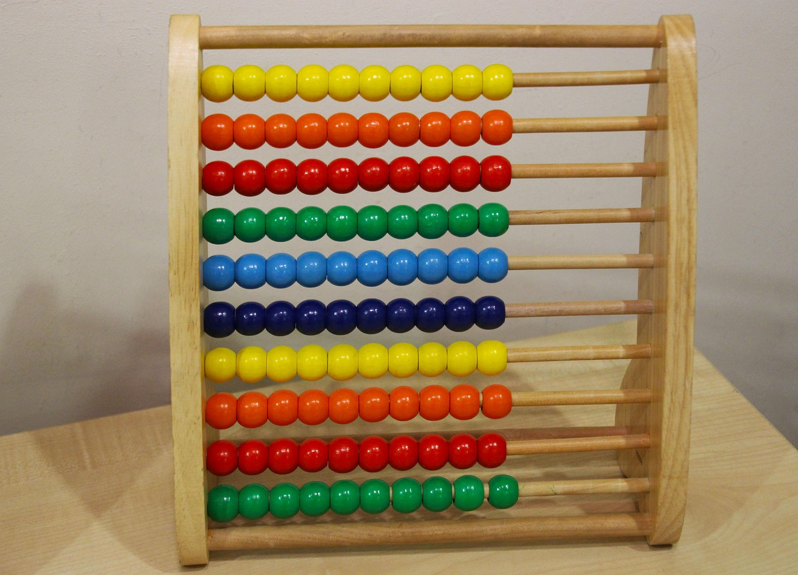
Abacus (3000 BC) — first arithmetic tool.

Slide 5
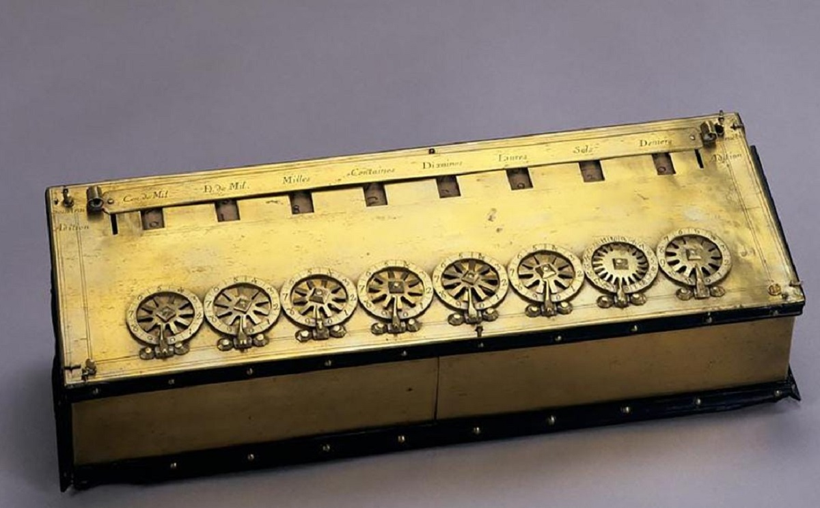
Pascaline (1642) — mechanical calculator by Blaise Pascal.

Slide 6
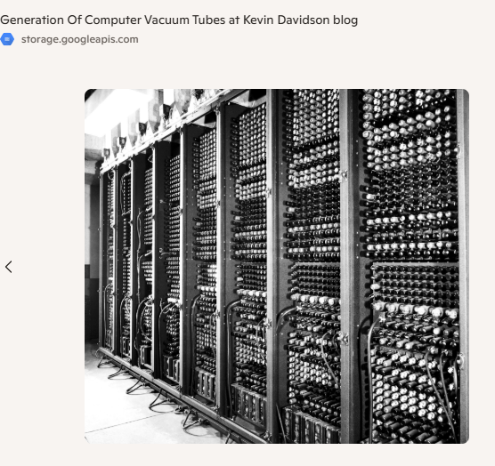
Analytical Engine (1837) — Charles Babbage’s design, with Ada Lovelace writing the first algorithm.

Slide 7
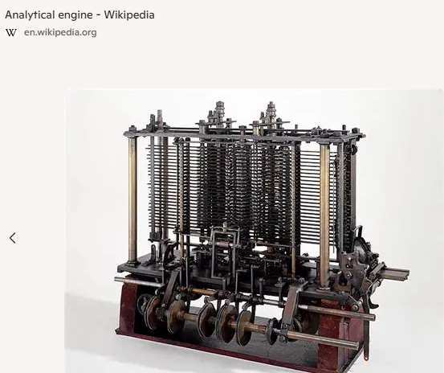

Slide 8
Generations of Computers
Generation | Years | Key Features
First | 1940s–1950s | Vacuum tubes, large, costly, unreliable.
Second | 1956–1963 | Transistors, faster, birth of FORTRAN & COBOL.
Third | 1964–1971 | Integrated circuits, smaller, more reliable.
Fourth | 1971–1980s | Microprocessors, personal computers emerge.
Fifth | 1980s–present | AI, cloud computing, parallel systems.

Slide 9
The Software Development Profession

Slide 10
What Developers Do?
Design & Build Applications: Mobile apps, enterprise systems, websites.
Problem-Solving: Translate real-world needs into algorithms and code.
Maintain & Debug: Ensure reliability and performance.
Collaborate: Work in teams using Agile, Scrum, or DevOps.

Slide 11
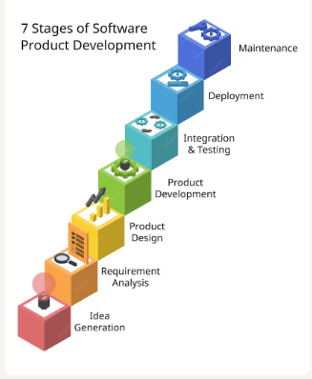

Slide 12
The 7 Stages of Software Product Development
Planning
Define the purpose of the software.
Identify stakeholders, goals, and constraints.
Example: Planning a mobile banking app to improve customer transactions.

Slide 13
2. Requirement Analysis
Gather functional and non-functional requirements.
Techniques: interviews, surveys, use cases.
Example: Users need secure login, balance checking, and fund transfer features.
Functional requirements - Specific features or functions the system must perform. “What the system should do”.
Non- Functional Requirements - Constraints or qualities that describe how the system performs its functions. attributes like performance, usability, reliability, and security.
Examples:
Performance — The website must load within 2 seconds under normal traffic.
Security — All user data must be encrypted using AES-256.
Usability — The mobile app must be intuitive enough for new users to complete a transaction within 3 steps.

Slide 14
3. Product Design
Create system architecture, database schema, and UI/UX mockups.
High-level design (modules, components) and low-level design (algorithms, data structures).
Example: Designing a clean dashboard for the banking app.
4. Product Development
Actual coding using programming languages (Python, Java, C++, etc.).
Follow coding standards and use version control (Git).
Example: Implementing login authentication with encryption.

Slide 15
5. Integration and Testing
Verify correctness, performance, and security.
Types: unit testing, integration testing, system testing, user acceptance testing.
Example: Testing fund transfer to ensure accuracy and security.
6. Deployment
Release the product to users.
Can be phased (beta release) or full-scale launch.
Example: Deploying the banking app to Google Play and App Store.

Slide 16
7. Maintenance
Fix bugs, update features, and adapt to new technologies.
Continuous improvement based on user feedback.
Example: Adding biometric login after initial release.
References
Schneider, G. M., & Gersting, J. L. (2022). Invitation to Computer Science (9th ed.). Cengage Learning.
Sommerville, I. (2016). Software Engineering (10th ed.). Pearson.
Pressman, R. S., & Maxim, B. R. (2019). Software Engineering: A Practitioner’s Approach (9th ed.). McGraw-Hill.

Slide 17
IT Professions in Software Development Stages

Slide 18
1. Planning
IT Professions: ₱70,000–₱150,000 (Project Managers up to ₱230,000–₱300,000)
Business Analyst — identifies business needs and goals.
Project Manager — oversees scope, timeline, and resources.
Product Owner — represents stakeholders and defines priorities.
2. Requirement Analysis
IT Professions: ₱50,000–₱120,000
Systems Analyst — translates user needs into technical requirements.
Requirements Engineer — documents functional and non-functional requirements.

Slide 19
3. Design
IT Professions: UI/UX Designers ₱70,000–₱150,000; Architects ₱120,000–₱200,000
Software Architect — designs system structure and components.
UI/UX Designer — creates user interface and experience flows. (Figma)
Database Designer — models data storage and relationships. (SQL)
4. Development
IT Professions:₱30,000–₱160,000 (PHP/NodeJS Developers ₱30,000–₱160,000; Mobile Developers ₱30,000–₱170,000)
Frontend Developer — builds user-facing features (HTML, CSS, JavaScript, React).
Backend Developer — implements server-side logic (Java, Python, Django).
Full-Stack Developer — works on both frontend and backend.

Slide 20
5. Testing
IT Professions: ₱50,000–₱130,000 (QA Managers ₱230,000–₱300,000)
Quality Assurance (QA) Engineer — designs and runs test cases.
Test Automation Engineer — builds automated test scripts.
Security Tester — ensures system is safe from vulnerabilities.
6. Deployment
IT Professions: DevOps ₱70,000–₱200,000; SysAdmin ₱30,000–₱150,000
DevOps Engineer — manages CI/CD pipelines, cloud deployment.
System Administrator — ensures servers and environments run smoothly.

Slide 21
7. Maintenance
IT Professions: ₱50,000–₱180,000 (Cybersecurity often ₱100,000–₱200,000+)
Support Engineer — handles bug reports and user issues.
Software Maintenance Engineer — updates and improves features.
Cybersecurity Specialist — monitors threats and applies patches.
References
Sommerville, I. (2016). Software Engineering (10th ed.). Pearson.
Pressman, R. S., & Maxim, B. R. (2019). Software Engineering: A Practitioner’s Approach (9th ed.). McGraw-Hill.
Schneider, G. M., & Gersting, J. L. (2022). Invitation to Computer Science (9th ed.). Cengage Learning.

Slide 22
Types of computers and their applications

Slide 23
Introduction
Computers have become an integral part of our daily lives, evolving from simple calculation machines to complex systems. In this section, we will cover the basics, explore their history, and discuss different types of computers.
What is a Computer?
Computer is an electronic device that processes data according to instructions provided by software programs. It takes input (data), processes it using a central processing unit (CPU), stores information, and produces output (results) to perform various tasks. It is widely used in fields such as education, business, communication, and entertainment for efficient and accurate operations.

Slide 24
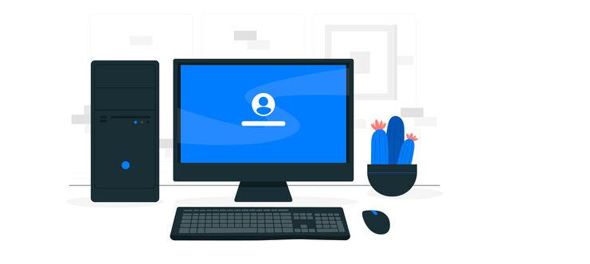
Types of Computers
There are various types of computers that are used today based on the needs of the user. Some of the types are:
Desktop: Desktops are mainly used for regular use, and they have separate components mounted together, like the monitor, keyboard, mouse, CPU, etc. Since the system is primarily kept on a desk for better usability, it is called a desktop.

Slide 25
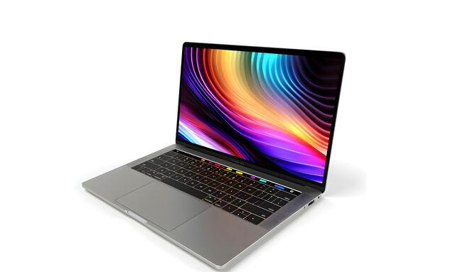
Laptop: Laptops are a portable version of desktops, with all the components integrated into a single unit thus providing mobility to the system. They are great for on-the-go work and come with built-in webcams, Bluetooth and Wi-Fi.

Slide 26
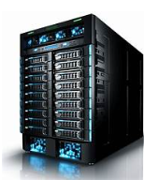
Servers: Servers are special types of computers that are used to manage network resources. They provide services to other systems and computers. Some of the primary tasks of servers include creating databases, hosting and providing support to other applications.

Slide 27
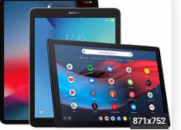
Tablets: Tablets are even more portable than laptops. They are smaller than laptops but are larger than smartphones. They come with touchscreens which makes them perfect for browsing the web, consuming content and personal communications.

Slide 28
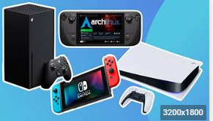
Other devices: Other devices include smartphones, game consoles, Smart TVs etc.

Slide 29
Classification of Computers (Based on size)
Computers can be categorized in various ways based on size, processing power, functionality, and other parameters. Here's an overview of the different types:
Supercomputers: These are extremely powerful computers that help in carrying out complex calculations. They aren't meant for personal use and are often used for research purposes.
Applications:
Weather forecasting and climate modeling.
Nuclear simulations and aerospace research.

Slide 30
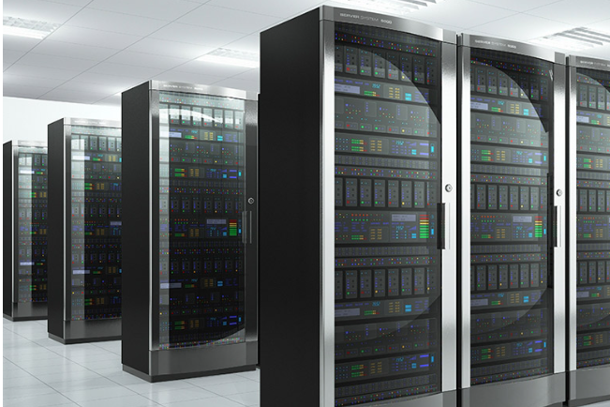
Mainframe computers: These are used by large organizations. They help in the processing of bulk data.
Applications:
Banking systems (transaction processing).
Airline reservation systems.
Government census and taxation.

Slide 31
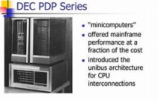
Minicomputers
Definition: Mid-sized computers, smaller than mainframes but larger than personal computers.
Applications:
Manufacturing process control.
Small to medium business data management.

Slide 32
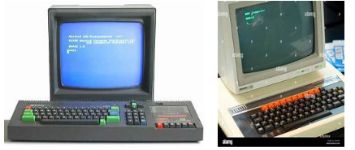
Microcomputers: These are designed for individual use. They are small, compact systems, such as smartphones and desktop computers.

Slide 33
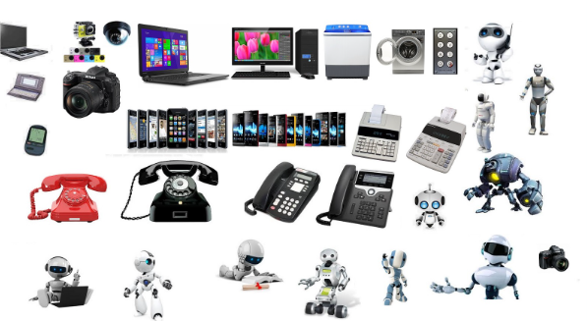
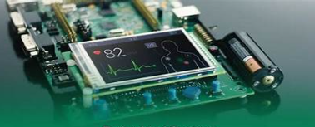
Classification of Computers (Based on Processing Power)
Embedded systems: Embedded systems are small computers that are built into other devices, such as appliances, cars, and medical devices. They are designed to perform specific functions and operate without human intervention.

Slide 34
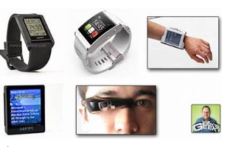
Wearable computers: Wearable computers are small, portable devices that are worn on the body, such as smartwatches or fitness trackers. They are designed to track data and provide information on the go.

